Slide 1
Task is given by mentorness Airplane Crashes
By – Sumit Mishra

Slide 2

AGENDA
1 . Temporal Analysis
2 . Geospatial Analysis
3 . Operator Performance
4 . Aircraft Analysis
5 . Fatality Trends
6 . Route Analysis

Slide 3
introduction
A comprehensive analysis of airplane crashes and fatalities spanning from 1980 to 2023. The dataset contains crucial information such as crash dates, locations, operators, flight details, aircraft types, and fatality statistics. The goal is to leverage for interactive visualizations and in-depth insights to understand patterns, contributing factors, and trends in aviation incidents.

Slide 4
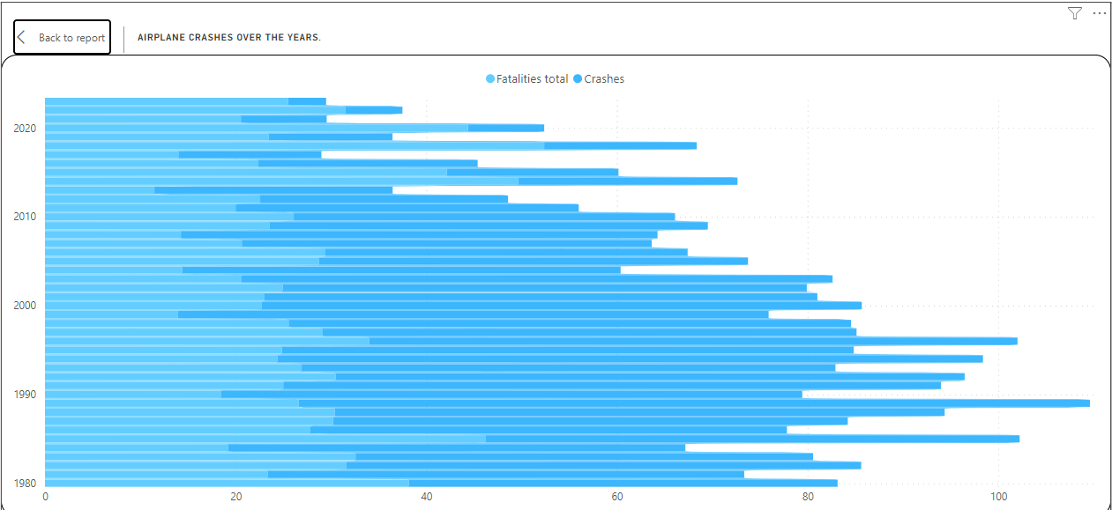
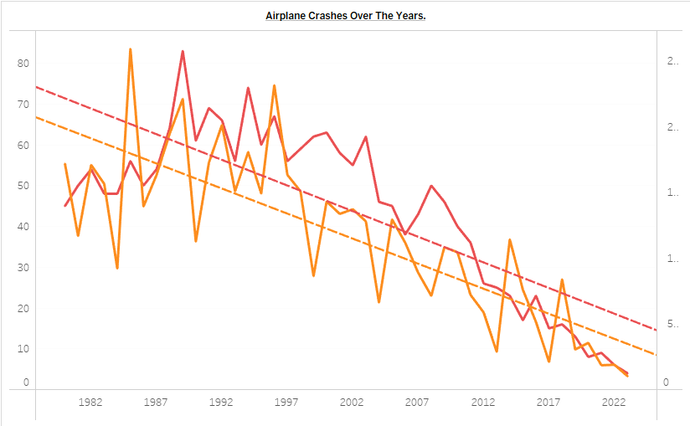
Temporal Analysis
This charts involves examining trends over time in airplane crashes.
Power Bi
Tableau

Slide 5
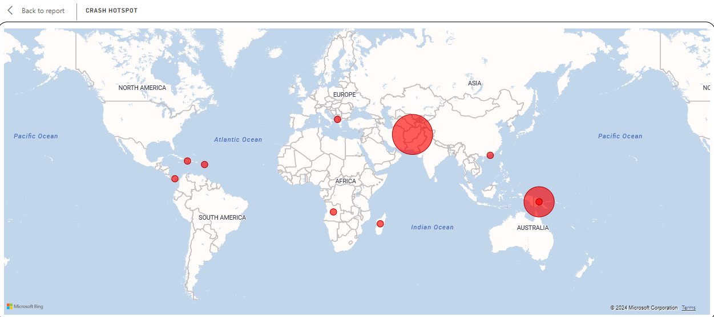
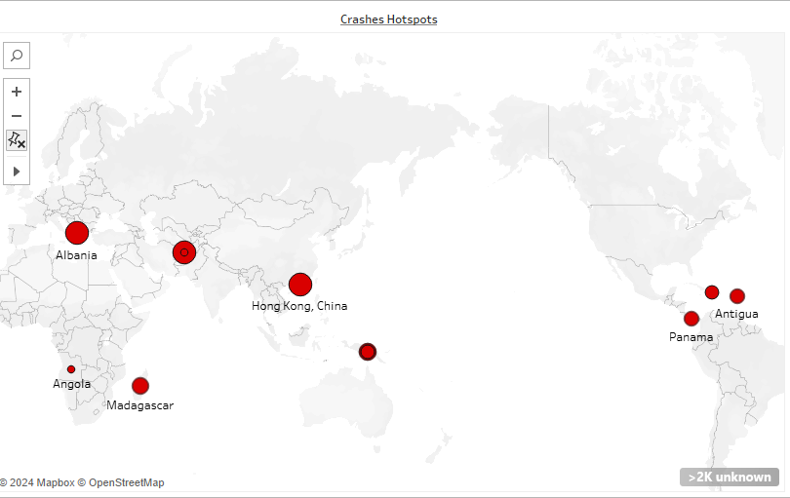
Geospatial Analysis
This focuses on visualizing crash locations on a map to identify areas with higher incident rates (hotspots).
Power Bi
Tableau

Slide 6
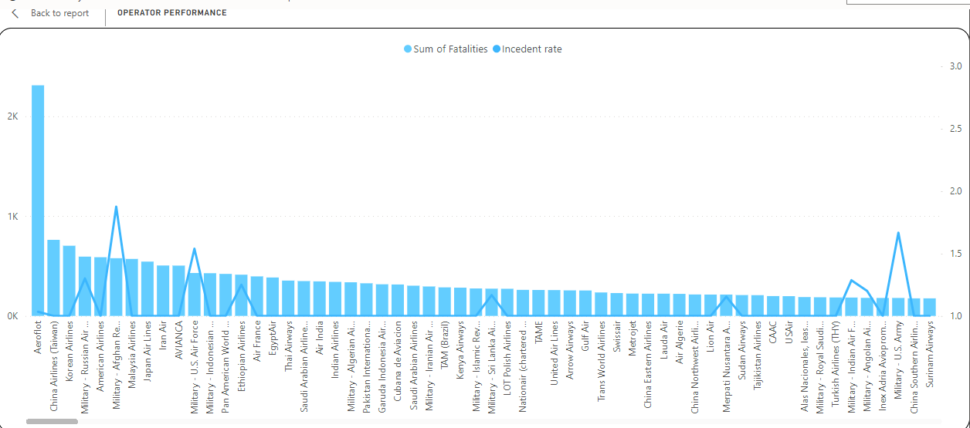
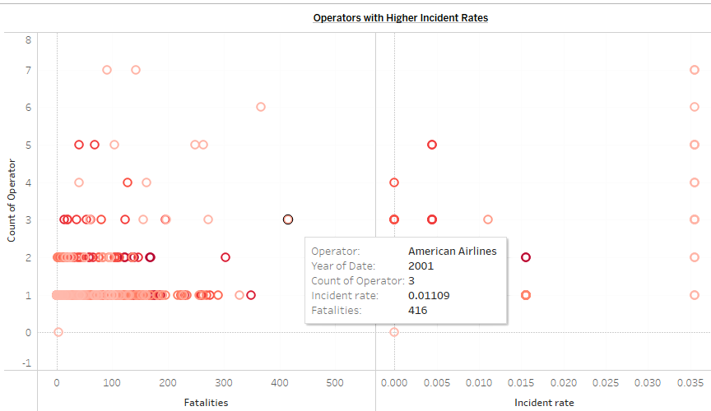
Operator Performance
Here, the safety records of different operators and airlines are evaluated.
Power Bi
Tableau

Slide 7
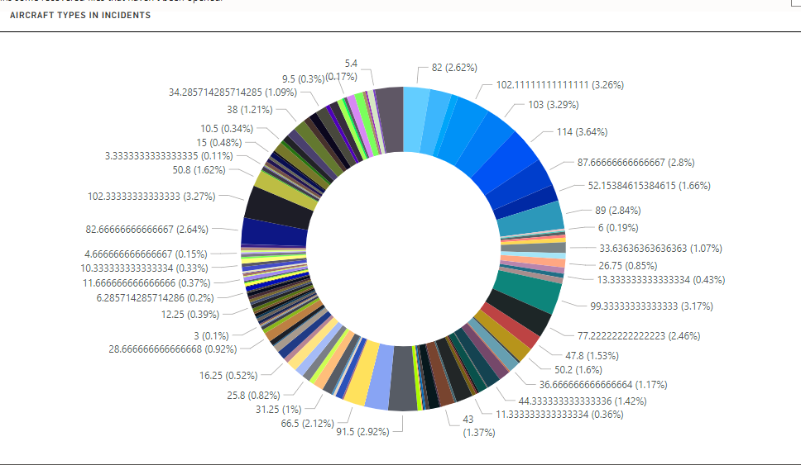
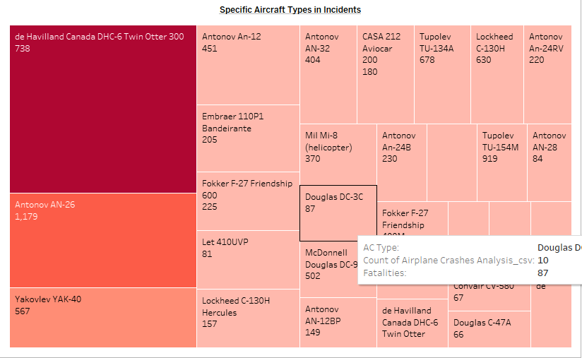
Aircraft Analysis
This involves analyzing the involvement of specific aircraft types in incidents.
Power Bi
Tableau

Slide 8
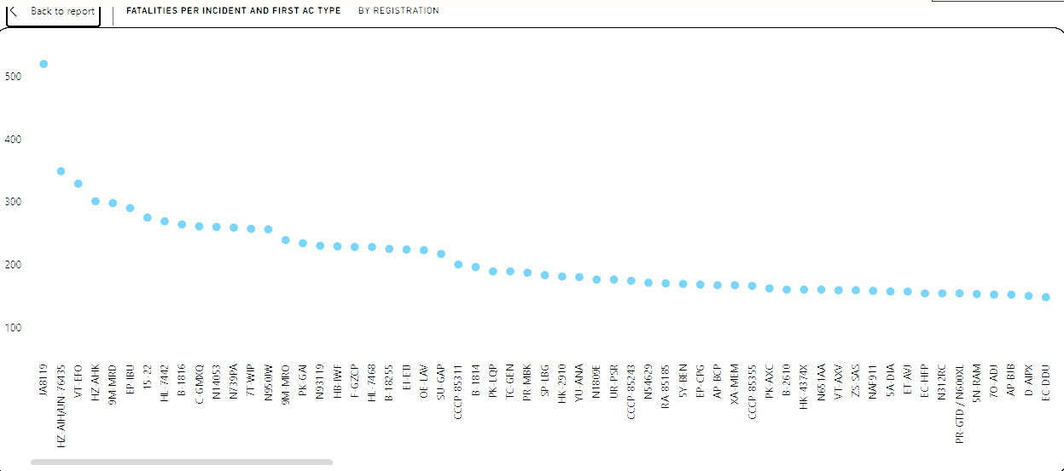
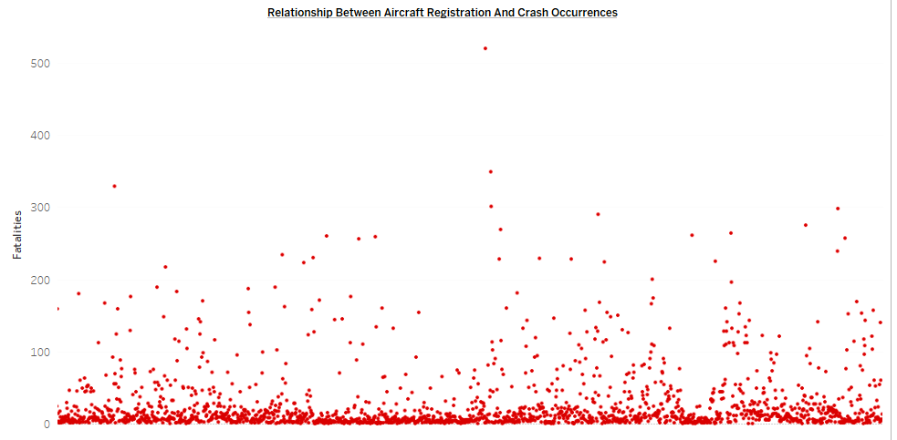
Relationship between Aircraft and registraion
This is a relationship chart between aircraft registration details and crash occurrences, potentially identifying any patterns or correlations.
Power Bi
Tableau

Slide 9
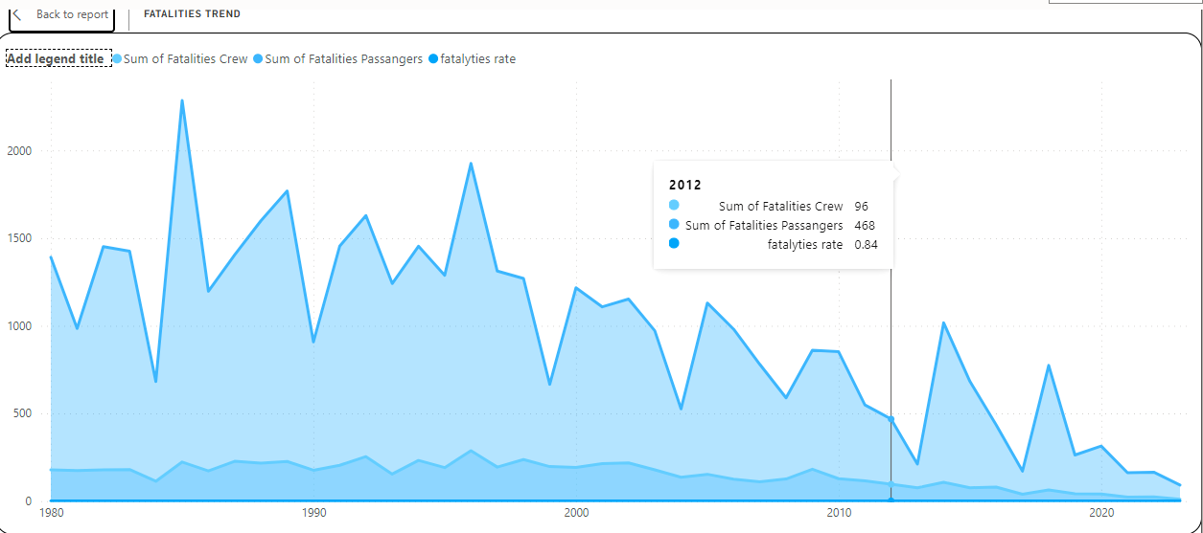
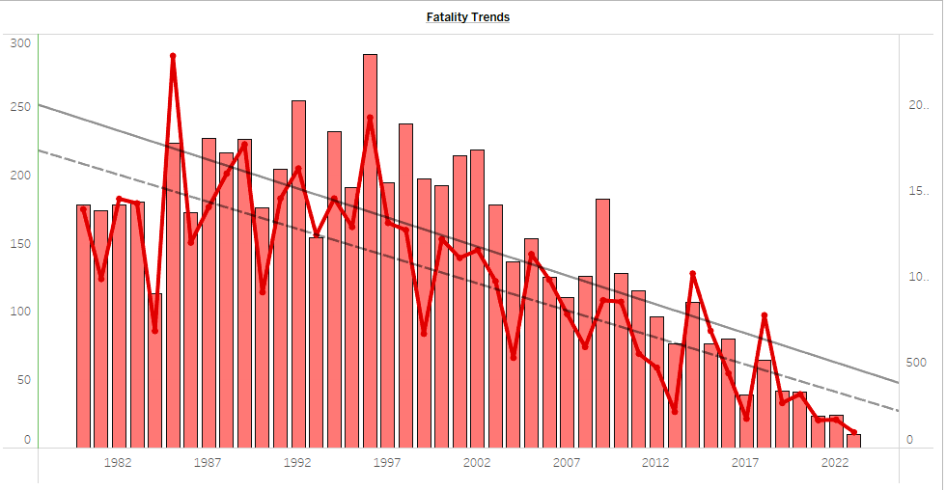
Fatality Trends
This objective revolves around exploring trends in passenger and crew fatalities resulting from airplane crashes.
Power Bi
Tableau

Slide 10
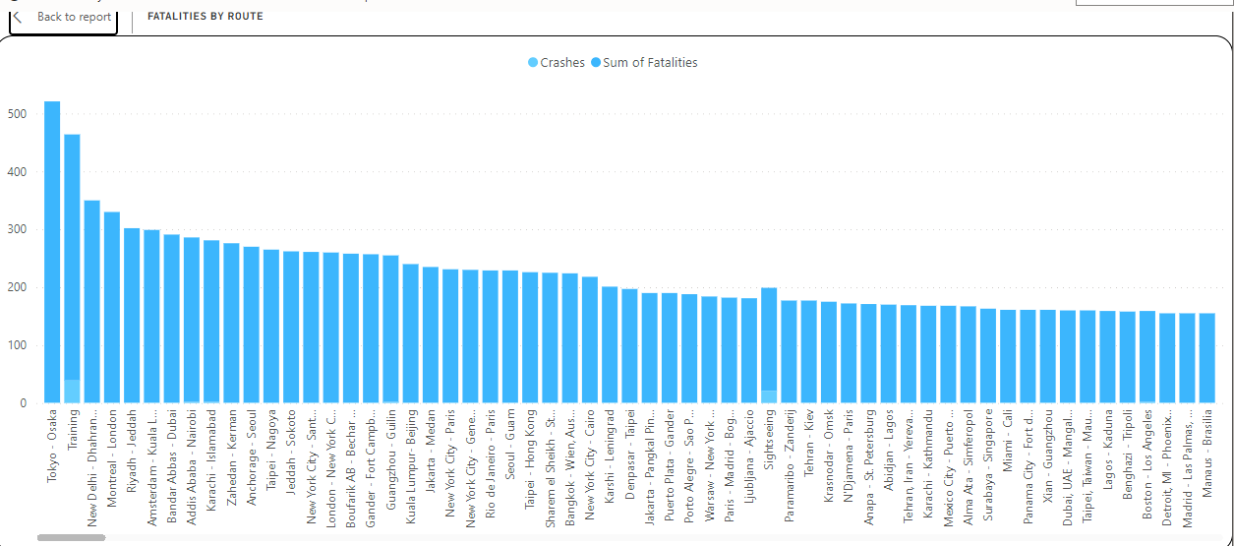
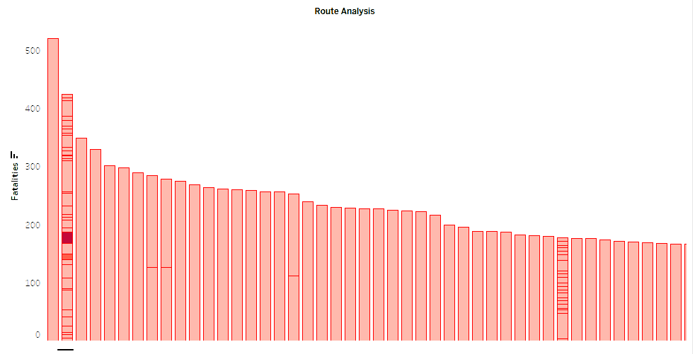
Route Analysis
Here, incident patterns on specific flight routes are analyzed.
Power Bi
Tableau

Slide 11
SUMMARY
The objectives include exploring temporal and geospatial trends, evaluating operator performance and aircraft involvement, and analyzing fatality trends and flight routes. Deliverables include interactive Power BI dashboards, reports on operator performance and fatality trends, and insights for improving aviation safety.

Slide 12

THANK YOU

